Slide 1
Enhancing Clinical Diagnosis with Advanced NLP
A Comparative Study of Retrieval Augmented Generation(RAG) Models
-Dong Jian, Kirti Prakash
Apr 18, 2024

Slide 2
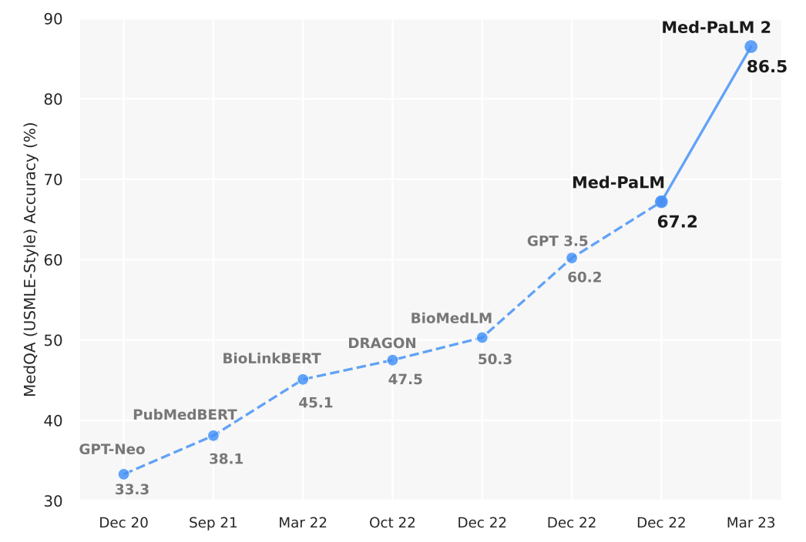
Towards Expert-Level Medical Q&A
Google's Med-PaLM(Pathways Language Model), for example, achieved 67% accuracy on USMLE-based MedQA questions; and Med-PaLM 2 achieved 86% accuracy.
We would explore other Q&A models to help primary healthcare providers with patient diagnosis.
Our RAG2 model produced a 78% correctness*, but this may not be directly comparable as we don’t treat it as a multiple-choice problem
Source: Singhal et al. Towards Expert-Level Medical Question Answering
with Large Language Models. arXiv:2305.09617(2023)
*Weighted avg F1 score and semantic similarity(details in evaluation section)
Notes:
Background & Motivation: Our team would like to explore medical Q&A models to help healthcare providers with patient diagnosis, so we can reduce medical professional’s time and allow patients ask questions to a virtual doctor assistant. There are lots of developments in medical Q&A in recent years. For example, as we see in this chart, Google's Med-PaLM achieved 67% accuracy on USMedical License Exam-based MedQA questions; and Med-PaLM 2 achieved 86% accuracy. And recent advancements in Large Language Models (LLMs), such as ChatGPT, showcase impressive capabilities for answering questions. But it encounter challenges like hallucination, outdated knowledge, and untraceable reasoning processes. With Retrieval-Augmented Generation (RAG), this can be solved by incorporating information from external knowledge bases. This enhances the accuracy and credibility of the generation, particularly for a knowledge-intensive task like medical Q&As.

Slide 3
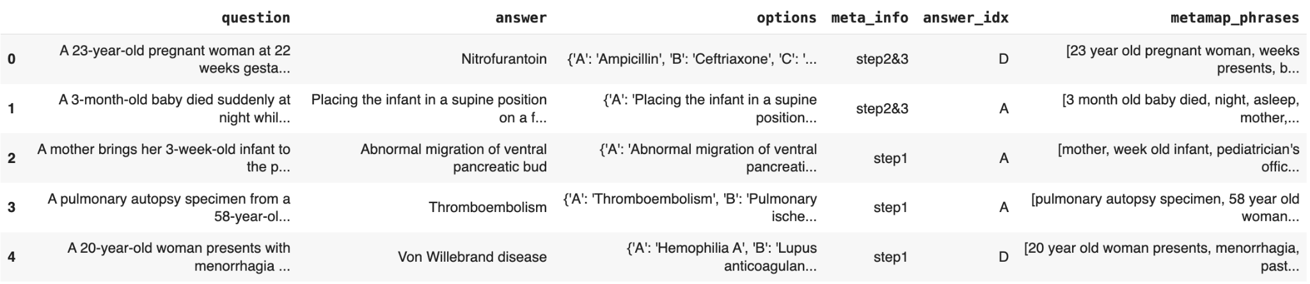
MedQA USMLE as Dataset
MedQA USMLE: United States Medical License Exams.
It has three sources: US, Mainland of China, and Taiwan District. We used the dataset in US.
~10k question, answer pairs.
Question Token Length: mean of 174, median of 162 and maximum of 911.
The RAG models retrieve using the question and answer fields
Notes:
consisting of 10K question-and-answer pairs
Our RAG model is using the first two columns here as an answer generation problem, rather than a multiple choice problem.

Slide 4
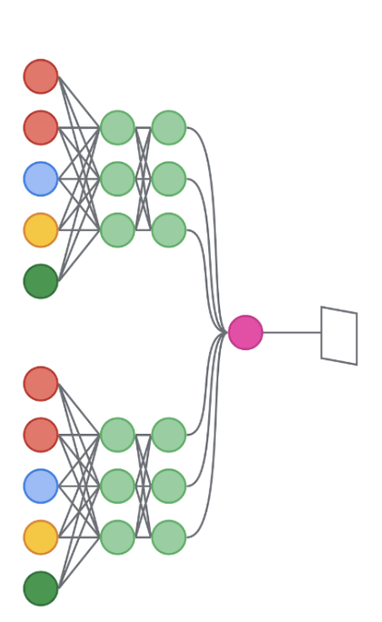
Models: What we did to improve
Documents
Query: Synthetic questions(1K)
Retrieval System(vector store)
MedQA USMLE Q&A pairs
10K
Encoder(sentence transformer)
LLM-Generate Answer
Query
Relevant Doc
Chunks
RAG1
multi-qa-mpnet-base-dot-v1
GPT-3.5-Turbo
documents
Query
RAG2
all-MiniLM-L6-V2
GPT-3.5-Turbo
documents
Chunk size=650, top-k=5
Notes:
Here are our models, RAG1(Baseline) and RAG2(improved model) both follow a similar architecture: a sentence transformer as the encoder, and a LLM as the decoder for answer generation. The LLM we used is GPT-3.5-Turbo for both models. The only difference is the encoder. With RAG1, the encoder is the multi-qa-mpnet-base-dot-v1 model, which is a masked pre-trained model similar to bert, then fine-tuned with 215M Q&A pairs ; and RAG2 is using the all-MiniLM-L6-v2 as the encoder, which is a more efficient model with 6 layers, and fine-tuned with a 1 billion sentence-pair dataset. The retrieval system retrieves the relevant document chunks based on the vector similarity to the query embeddings. Here, the query is 1k synthetic questions produced by GPT-3.5 with prompt tuning.
Not to speak, only reference below:
the multi-qa-mpnet-base-dot-v1 transformer used a pre-trained “mpnet-base” model and fine-tuned with 215 million(question, answer) pairs, lower than all-MiniLM-L6-v2. MPNet, which stands for Masked and Permuted Pre-training for Language Understanding, combines the strengths of masked language modeling (like in BERT) and permuted language modeling (like in XLNet).
The all-MiniLM-L6-v2 sentence transformer utilizes the pre-trained MiniLM-L6-H384-uncased model and is fine-tuned with a 1 billion sentence pairs dataset, including GOOAQ[1], SQuAD2.0[2], SearchQA[3], and PAQ[4]. The MiniLM architecture[5] is known for its smaller, more efficient models that retain the performance characteristics of larger models. MiniLM, which is a smaller, distilled version of larger transformer models like BERT or RoBERTa, offering similar capabilities but with fewer parameters and lower computational requirements. The "L6" indicates that the model has 6 layers, making it more lightweight compared to deeper models.

Slide 5
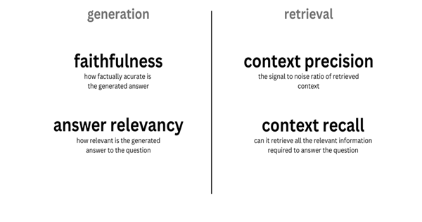
Evaluation metrics using Ragas
answer correctness
accuracy of the generated answer when compared to the ground truth
Notes:
Prior works with models for clinical question and answers utilized metrics such as classification accuracy, or natural language generation metrics such as BLEU[6], however these scores fail to capture the clinical quality of consultations.
Medical diagnosis and consultations also require human evaluators.
Additionally, RAG architectures also pose a unique challenge because of the different factors involved.
These include:
the retrieval system in finding the correct and relevant context reference passages,
the LLM to generate to answer in a grounded and faithful manner, and
the overall quality of the generated output
As we did not have specially trained resources for human evaluation, we choose to use LLM assisted Ragas framework for evaluation. With Ragas, we choose: 1) for retrieval: context precision, context recall, context entity recall 2) for generation: faithfulness, answer relevancy, answer similarity 3) for overall quality: answer correctness metric

Slide 6
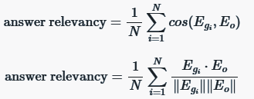
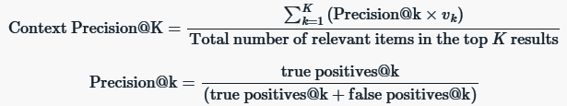


Metric calculations
Faithfulness Aka Groundedness: How factually
correct the answer is to the ground truth
Answer Relevance: How related the
generated answers are to the questions asked
Context Precision: How precise the model is in
selecting relevant top k ranked document chunks
Context Recall: How well the retrieval component
of the system is able to fetch relevant sentences within the context
of the query
Context Entities Recall: What fraction of entities are recalled from ground truth
Answer Correctness: Accuracy comparing semantic similarity
and factual similarity (F1 score).
Notes:
Speaker: Briefly, for reference these are how the metrics are calculated.
Not to speak, only reference below: if any question on Answer Correctness: Answer correctness: Gauges the accuracy of the generated answer when compared to the ground truth, looking at two key aspects of semantic similarity and factual similarity. Factual correctness quantifies the factual overlap between the generated answer and the ground truth answer. This is done using the concepts of:
TP (True Positive): Facts or statements that are present in both the ground truth and the generated answer.
FP (False Positive): Facts or statements that are present in the generated answer but not in the ground truth.
FN (False Negative): Facts or statements that are present in the ground truth but not in the generated answer.
Then, calculate the semantic similarity between the generated answer and the ground truth. Once we have the semantic similarity, we take a weighted average of the semantic similarity and the factual similarity calculated above to arrive at the final score. You can adjust this weightage by modifying the weights parameter.

Slide 7
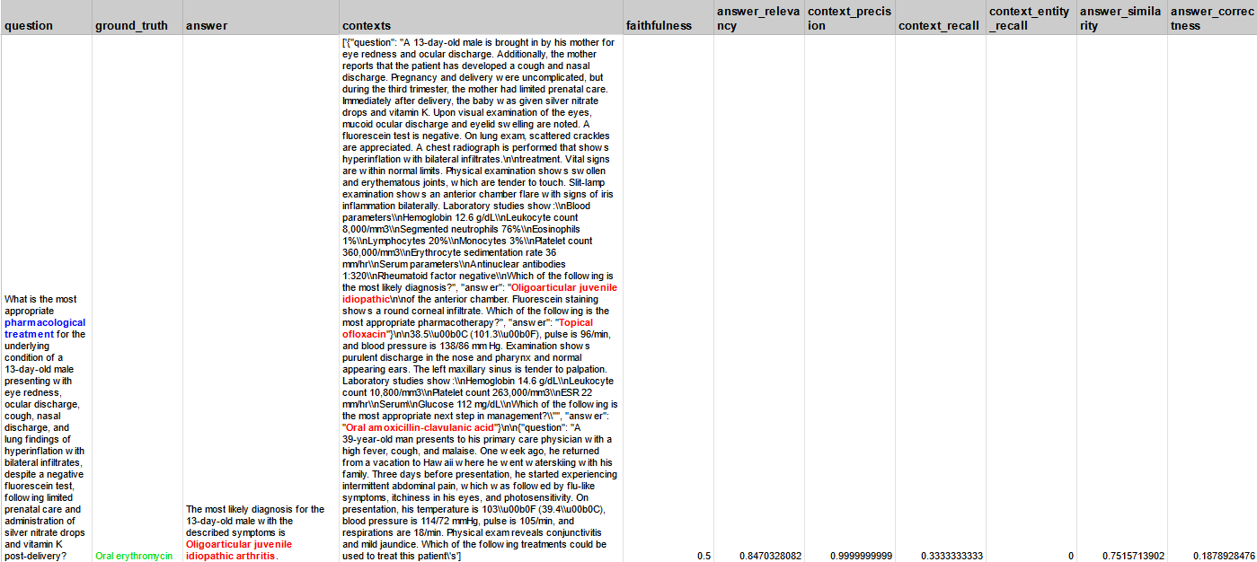
Example using RAG1
Notes:
Here’s an example of what we saw with RAG1 model. The question asked for pharmacological treatment with patient vignette provided.
In case, you were wondering that treatment means: (drugs/medicine)
Ground truth answer is Oral erythromycin (antibiotics for infections).
We can see context chunks retrieved along with possible answer included:
Oligoarticular juvenile idiopathic, (juvenile arthritis)
Topical ofloxacin (antibiotic for bacterial infections),
Oral amoxicillin-clavulanic acid (Amoxicillin is a penicillin antibiotic that fights bacteria) This clearly incorrect, thus our faithfulness score is 0.5 and answer correctness is 0.18

Slide 8
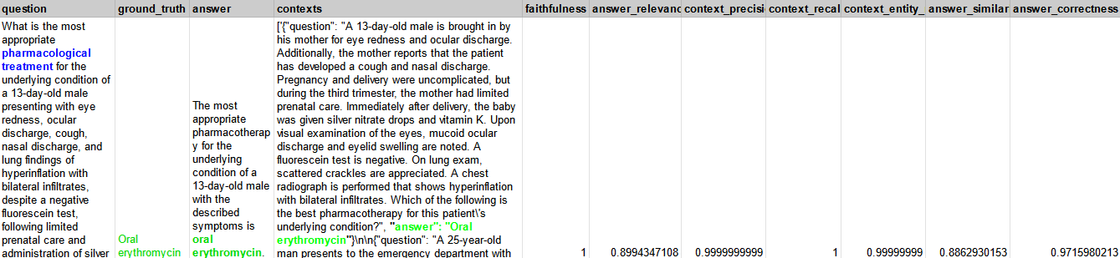
Example using RAG2
Notes:
In contrast, here’s an example of what we saw with RAG2 model.
We can see context retrieved along with possible answer included: …
The correct answer is Oral erythromycin
This is clearly correct, thus our faithfulness score is 1 and our answer correctness has increased to 0.97

Slide 9
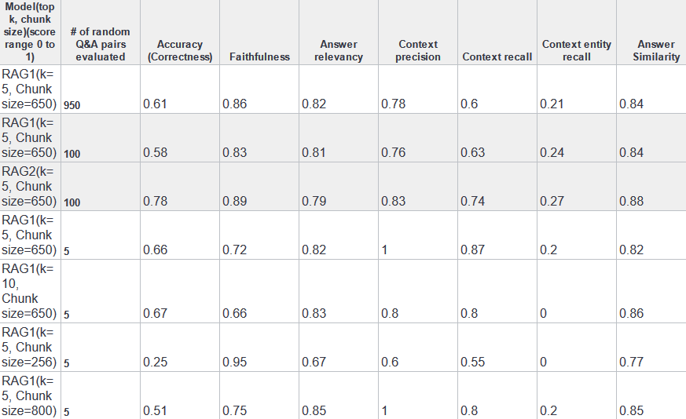
Model Evaluation Results
Notes:
Our results:
We experimented with a random sample of 1000 QA (reduced to 950 due to processing limits)
We got an Answer Correctness / accuracy of 0.61 with RAG1 at that point.
Later, we reduced this to 100 questions. We tried few iterations with different hyperparameters and settled on K as 5 and Chunk as 650 as optimum We also noticed a significant jump to 78% in accuracy after upgrading the sentence transformer model to a more efficient one: all-MiniLIM-L6-v2 over multi-qa-mpnet-base-dot-v1
Likely a byproduct of larger training corpus: 1 billion sentence pairs including GOOAQ, SQuAD2.0 and other Q&A datasets

Slide 10
Limitations
Limited medical datasets for validation and refinement
Medical professionals needed
Reliance on LLM generation of alternative synthetic questions
Ground truth answers currently in multiple choice format answer style, not real world dialogue response
Limited compute resources needed for full validation and tuning
LLM and Tokenization limits (LLM API spend, TPM)
Notes:
Limited medical datasets for validation and refinement
Medical professionals needed for human annotation and evaluation
Reliance on LLM generation of alternative synthetic questions
Ground truth answers currently in multiple choice format answer style, not real world dialogue response
Limited compute resources as well LLM and Tokenization limits needed for full validation and tuning

Slide 11
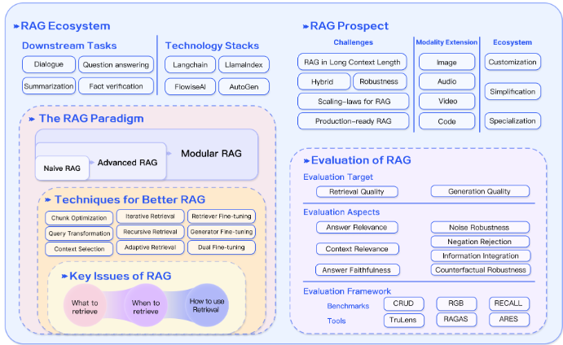
Suggested future model experiments
BioLinkBERT-base, an encoder pre-trained on PubMed
Human Feedback loops including Medical Licensed professionals to review outputs of predicted answers
Additional medical knowledge bases
MedLM / Med-Palm 2 (restricted access)
Other RAG techniques in
Ecosystems, Paradigms, Prompting
Evaluation Frameworks
Source: Retrieval-Augmented Generation for Large Language Models: A Survey
Notes:
For future model experiments, would suggest:
BioLinkBert
Using Medical Licensed professionals for review
Adding additional corpus of medical texts
Explore MedLM / Med-Palm 2. Right now it has restrict access
Other RAG techniques: Ecosystems, Paradigms, Prompting, Evaluation Frameworks as show in this image from recent paper.

Slide 12
Q & A
Thank you!

